Slide 1
Classical Networking Introduction
QuTech, Delft
© Bruno Rijsman, brunorijsman@gmail.com, 28 June 2019 v1

Slide 2
The Internet: a network of networks
Notes:
IP was originally intended to glue networks together using different protocols (X25, DECnet, IBM SNA). Now most all networks use IP also internally, with a few exceptions (SCADA industrial networks, Fibre channel in storage networks,

Slide 3
Hosts: the end-point devices
User devices
Servers
IoT devices

Slide 4
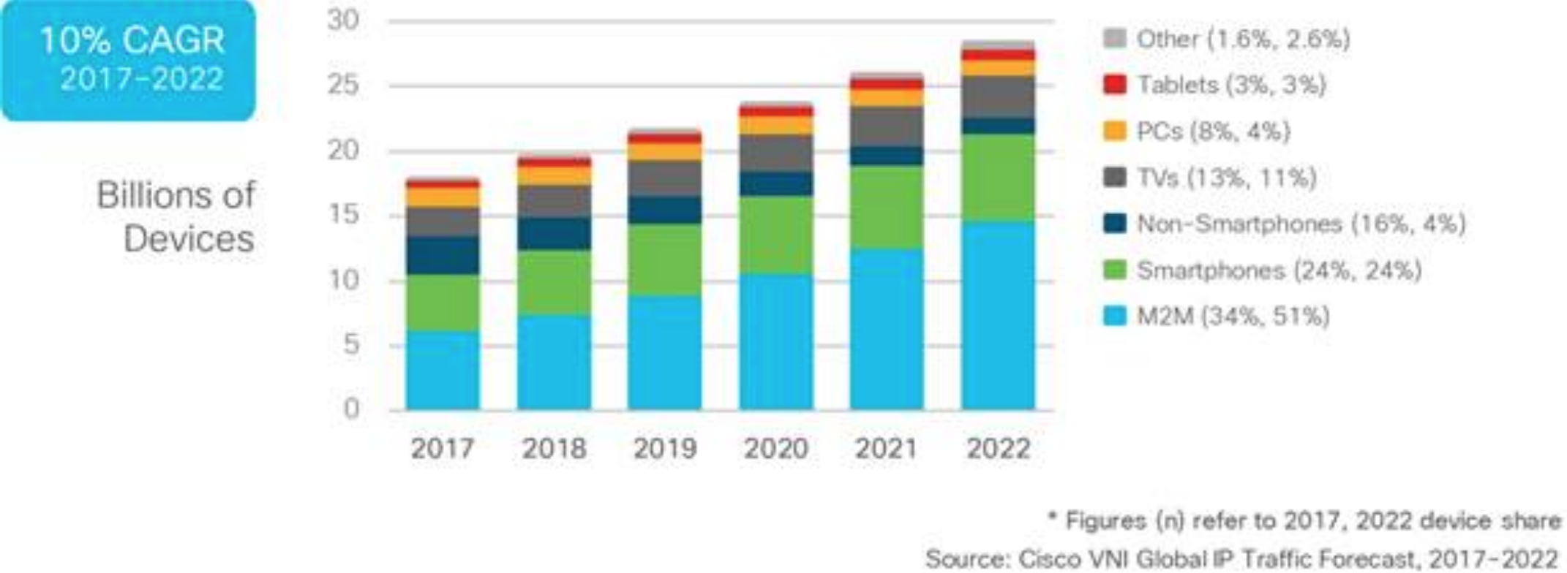
Tens of billions of end-point devices

Slide 5
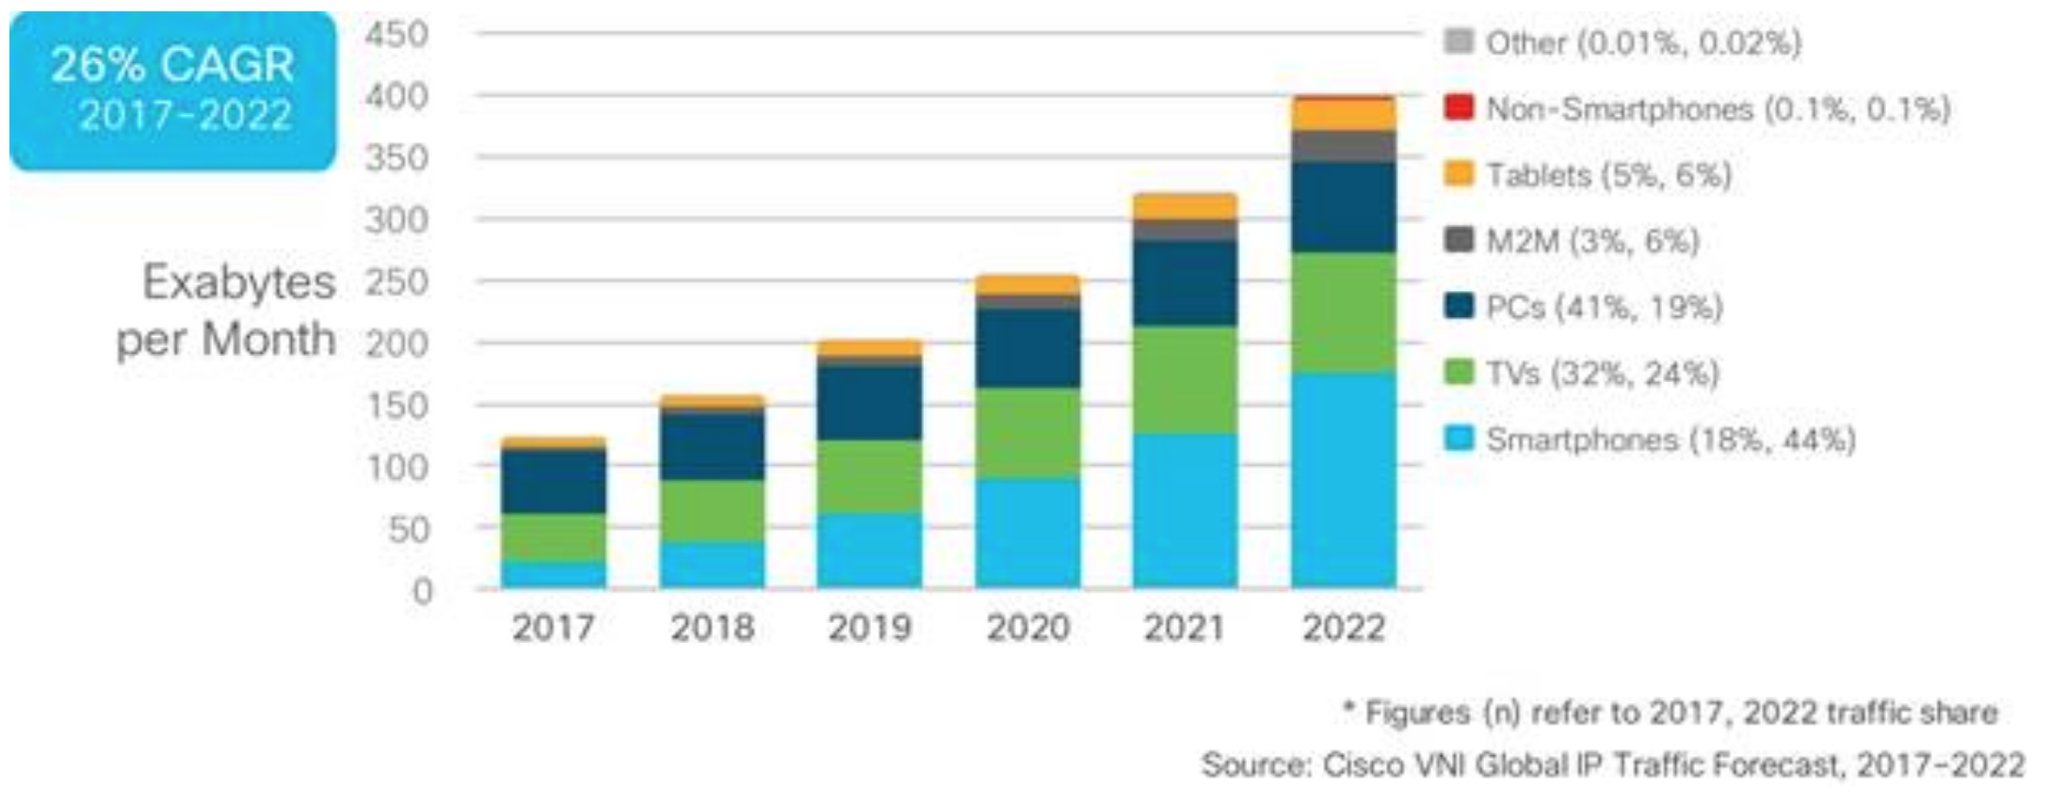
Hundreds of exabytes (10¹⁸ bytes) per month

Slide 6
Autonomous systems: administrative domains
Service providers
Large companies
Total > 50,000
Notes:
Operator or multi-homed enterprise. Can overlap topologically (”on top of each other” on map).

Slide 7
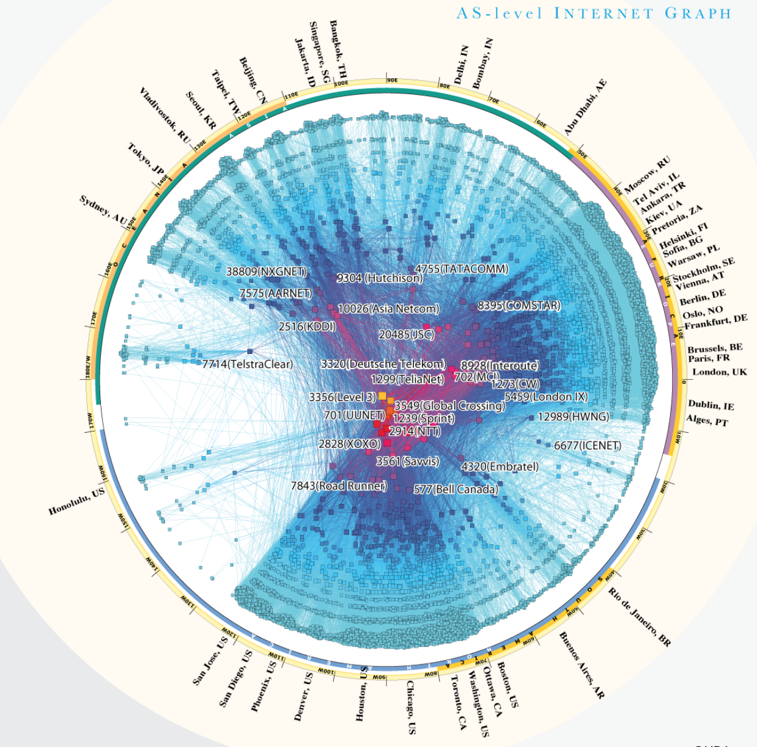
Maps of the internet (at AS level of detail)

Slide 8
Routers: devices that forward “IP” packets

Slide 9
IPv4: unreliable datagram service
Packet by packet forwarding
Each packet has a destination IP address
Packets may be dropped, delayed, re-ordered, duplicated
End-points use higher-layer protocols (e.g. TCP) to make it reliable

Slide 10
L3 Internet Protocol (IP): datagram service
Laptop
L3 Router
L3 Router
Server
IP Header
IP
IP
IP
IP

Slide 11
L4 TCP: reliable end-to-end connections
Laptop
L3 Router
L3 Router
Server
TCP Header
IP Header
TCP
TCP
IP
IP
IP
IP

Slide 12
L7 application protocol: e.g. HTTP, FTP, …
Laptop
L3 Router
L3 Router
Server
HTTP Payload
HTTP Header
TCP Header
IP Header
HTTP
HTTP
TCP
TCP
IP
IP
IP
IP

Slide 13
L2 Ethernet: Local Area Network (LAN)
Laptop
WIFI AP
L3 Router
L3 Router
L2 Switch
Server
HTTP Payload
HTTP Header
TCP Header
IP Header
Ethernet Header
HTTP
HTTP
TCP
TCP
IP
IP
IP
IP
Ethernet
Ethernet
Ethernet
Ethernet
Ethernet
Ethernet

Slide 14
L1 physical layers: WIFI, electrical, optical…
Laptop
WIFI AP
L3 Router
ROADM
L3 Router
L2 Switch
Server
HTTP Payload
HTTP Header
TCP Header
IP Header
Ethernet Header
HTTP
HTTP
TCP
TCP
IP
IP
IP
IP
Ethernet
Ethernet
Ethernet
Ethernet
Ethernet
Ethernet
Wifi
Wifi
Elec
Elec
Opt
Optical
Optical
Optical
Optical

Slide 15
The OSI reference model
Layer number | Layer name | Responsibility | Examples
Layer 7 | Application | End-user functionality | HTTP, FTP, SMTP
Layer 6 | Presentation | Encoding | ASN.1, GPB, Thrift
Layer 5 | Session | Dialogue control, checkpointing | -
Layer 4 | Transport | Reliable end-to-end stream, end-to-end flow control, segmentation | TCP, QUIC, UDP
Layer 3 | Network | Global addressing, routing, fragmentation, quality of service. | IPv4, IPv6, IPX
Layer 2 | Datalink | MAC: Coordinate access to a shared medium. LLC: Group bits into frames, handle bit errors, point-to-point connections and flow-control | IEEE 802 series (Ethernet) PPP
Layer 1 | Physical | Send and receive bits over physical medium. | Ethernet 1000BASE-T SONET/SDH

Slide 16
Each end-point has an IP address (IPv4 or IPv6)
140.13.8.12
13.243.77.102
13.231.8.19
140.13.243.22
13.225.7.9
140.13.106.3
13.224.13.9
140.13.12.99
13.224.5.2
45.9.3.17
45.9.3.28
45.9.3.102
45.9.3.87
Notes:
Routers also known as gateways (for example Border Gateway Protocol) for historical reasons.

Slide 17
IP addresses have topological significance
13.224.0.0 / 12
140.13.0.0 / 16
140.13.8.12
13.243.77.102
13.231.8.19
140.13.243.22
13.225.7.9
140.13.106.3
13.224.13.9
140.13.12.99
13.224.5.2
45.9.3.0 / 24
45.9.3.17
IP addresses can be aggregated (= summarized) into IP prefixes
45.9.3.28
45.9.3.102
45.9.3.87

Slide 18
Routers do lookup in forwarding table (FIB)
Looks up the destination IP address for each individual packet
Forwarding table (FIB) of router R1
Destination | Next-hop
10.1.1.2 / 32 | Interface 1
10.2.1.2 / 32 | Interface 2
10.3.1.2 / 32 | Interface 3
10.3.2.2 / 32 | Interface 3
Host
H1
Router
R1
Router
R2
Host
H4
1
3
1
3
10.1.1.2
2
2
10.3.2.2
Forwarding table (FIB) of router R2
Host
H2
Host
H3
Destination | Next-hop
10.1.1.2 / 32 | Interface 1
10.2.1.2 / 32 | Interface 1
10.3.1.2 / 32 | Interface 2
10.3.2.2 / 32 | Interface 3
10.2.1.2
10.3.1.2

Slide 19
Aggregation and longest prefix match
Use aggregation to reduce forwarding table size
Default route is special case
Forwarding table (FIB) of router R1
Destination | Next-hop
10.1.1.2 / 32 | Interface 1
10.2.1.2 / 32 | Interface 2
10.3.0.0 / 16 | Interface 3
10.3.0.0/16
Host
H1
Router
R1
Router
R2
Host
H4
1
3
1
3
10.1.1.2
2
2
10.3.2.2
Forwarding table (FIB) of router R2
Host
H2
Host
H3
Destination | Next-hop
0.0.0.0 / 0 | Interface 1
10.3.1.2 / 32 | Interface 2
10.3.2.2 / 32 | Interface 3
10.2.1.2
10.3.1.2

Slide 20
Addressing
Datalink: Ethernet address
Just happens to be globally unique
No topological significance (“flat address space”)
Not managed (burned into chip)
Network: IPv4 address (32 bits) or IPv6 address (128 bits)
Originally intended to be unique on the Internet
Private IP addresses (e.g.10/8), NAT, and anycast complicate matters
Topological significance; allows for aggregation; makes the Internet scale
Very carefully managed (complex procedures for allocating and assigning IP addresses)
Transport: Port numbers
Identify service (“socket”) running on a particular server
Notes:
Routers also known as gateways (for example Border Gateway Protocol) for historical reasons.

Slide 21
Naming
Domain name: human readable name
Identifies a service
Example: www.google.com (not https://www.google.com/somepage)
The Domain Name System (DNS) protocol translates a name to an IP address
One DNS name can map to multiple different IP addresses (for load balancing – other mechanisms exist as well)
The mappings can change over time (for resilience)
DNS is highly decentralized and scalable
Notes:
Routers also known as gateways (for example Border Gateway Protocol) for historical reasons.

Slide 22
Control plane versus data plane
Router
Control plane
Discover network topology and resources
Program the forwarding plane (e.g. forwarding table)
Flexibility is main concern
Control Plane
(software)
Data plane (aka forwarding plane)
Forward packets
Using the forwarding table populated by the control plane
Speed is main concern
Data Plane
(usually hardware)

Slide 23
Control plane versus data plane
Router
Control Plane
(software)
Data Plane
(usually hardware)

Slide 24
Control plane - data plane interface
Router
Control plane – data plane interface
Configure networking devices (e.g. set interface address)
Program forwarding plane (e.g. add entry to forwarding table)
Send and receive control plane packets (”punting”)
Retrieve statistics
Historically proprietary (SDK provided by chip vendor)
Standards: ForCES, OpenFlow, SAI, Netlink, P4 generated…
Control Plane
(software)
Data Plane
(usually hardware)

Slide 25
“Traditional” distributed control plane
Control plane protocols OSPF, ISIS, BGP, PIM, RSVP, LDP, …
Router
Control Plane
Data Plane
Router
Router
Control Plane
Control Plane
API proprietary, ForCES, OpenFlow, SAI, P4 generated…
Data Plane
Data Plane
Data plane protocols IPv4, IPv6, MPLS, …
Notes:
Out-of-band vs in-band.

Slide 26
SDN: centralized control plane (simplified)
Controller
Control Plane
API proprietary, ForCES, OpenFlow, SAI, P4 generated…
Forwarding element
Data Plane
Forwarding element
Forwarding element
Data Plane
Data Plane
Data plane protocols IPv4, IPv6, MPLS, …
Notes:
Out-of-band vs in-band.

Slide 27
Example forwarding plane chip
Broadcom Tomahawk 3
12.8 terrabits per second (Tbps)
128 x 100G interfaces
8 billion packets per second
0.04 nano seconds to forward 1 packet
Relatively small forwarding tables (480K)
Shallow buffers (internal shared 64MB)
Lean feature set

Slide 28
The responsibilities of the forwarding plane
For each packet: layer 3 longest prefix match lookup of destination IP address
Actually, a lot more than that:
Layer 2 exact match lookup of destination Ethernet address
Buffer packets in case of congestions
Scheduling for Quality of Service (QoS)
Lookup of source address for validation and learning
Compute hash for Equal Cost Multipath (ECMP)
Apply policies (ACLs)
Track metrics (counters, thresholds, …)
Make copies for multicast and taps
… etc. etc. etc.

Slide 29
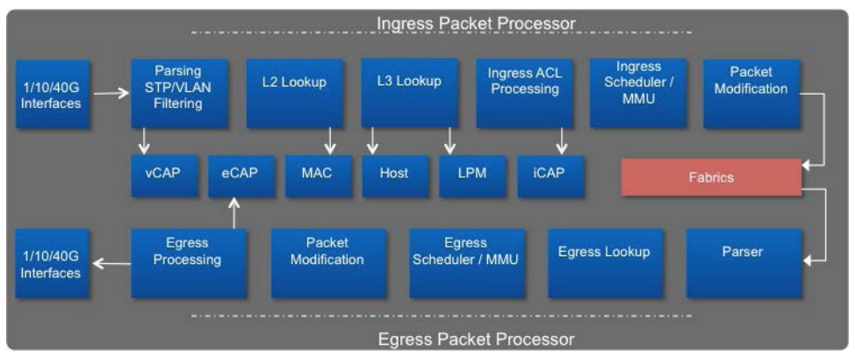
Example fixed forwarding spipeline

Slide 30
Traditional distributed routing protocols
Intra-domain routing protocols
Exchange routes inside autonomous system
All routers owned and operated by same organization
Higher level of trust, more information available
Emphasis on shortest path
Example: OSPF, ISIS, EIGRP, RIP, RIFT, BGP (!), ….
Inter-domain routing protocols:
Exchange routes between autonomous systems
Routers owners by different organizations
Lower level of trust, less information available, real money is involved
Emphasis on implementing business policies (customers, transit, peering, …)
Only one protocol: BGP version 4

Slide 31
Routing protocol algorithms
Link State Routing
Every router discovers full topology and computes shortest path
The dominant algorithm for intra–domain routing
Open Shortest Path First (OSPF)
Intermediate-System to Intermediate-System (ISIS)
Vector Routing
Distance-Vector or Path-Vector
Routers do not know full topology
Each router locally choses best path and propagates that path
Routing Information Protocol (RIP)
Border Gateway Protocol (BGP)

Slide 32
Intra-domain vs inter-domain (simplified)
BGP
ISIS
BGP
BGP
OSPF
BGP
ISIS

Slide 33
Other control plane protocols
Traffic engineering protocols:
Used to
RSVP, LDP, BGP-LU, ISIS-TE, OSPF-TE, Segment Routing
Multicast protocols:
IGMP, MLD, PIM (several modes)
Service protocols:
L3VPN, L2VPN, EVPN, …
Management protocols:
SSH, SNMP, NETCONF, FTP, …
Telemetry protocols
NetFlow, GPB, …
Notes:
Routing

Slide 34
Next seminars
Deeper dive into routing protocols
Open Shortest Path First (OSPF)
Intermediate System to Intermediate System (ISIS)
Border Gateway Protocol (BGP)
Traffic engineering
Multi-Protocol Label Switching (MPLS)
Resource Reservation Protocol (RSVP)
Path Computation Element Protocol (PCEP)
Software Defined Networking (SDN)
SDN motivations and applications
OpenFlow
Programming Protocol-independent Packet Processors (P4)
Notes:
Routing

